Slide 1
EMBEDDED SYSTEMS PROJECT
Team number 37: NOISE/SOUND DETECTION AROUND CAMPUS
Arathy Rose (2018101042)
Prerna Gupta (2018101114)
Radhika Rao (2018111015)

Slide 2
PROJECT DESCRIPTION
This project is expected to monitor and report the sound levels received at various places inhabited by the community and present it suitably.
As the IIITH campus is bounded by two main roads (CR Rao road and ISB road), this project determines the duration and days on which the traffic noise would be maximum and discuss ways to control it.
The campus is also quite close to the Gachibowli stadium. The noise from the stadium is also monitored and if it crosses a certain limit (during night times), the situation can be dealt with suitably.

Slide 3
USE CASE / PROJECT OBJECTIVE
To design a circuit/IoT device that would measure the sound level(in decibels) and perform analytics on it. This tentatively involves recording the frequency and timing of the event when sound exceeds ambient sound level (above 85 dB).
Using the above statistics, it is possible to create a noise map of the different areas in campus, which can be used in the future for allocating residents to less noise prone areas.
Possible additional features include warning bulb, sending alerts on phone via WIFI, determining the cause of the noise (that is, whether the noise is produced by the traffic or some procession on the roads, or by some event occurring in the stadium, or the inhabitants themselves) etc.

Slide 4
SCOPE:
COMPONENTS
ESP 32 NodeMCU Development Board
Sound sensor with sound recording capabilities (https://wiki.dfrobot.com/Analog_Sound_Sensor_SKU__DFR0034)
Server
Other components required for making the circuit like the PCB, wires, power source, WiFi source etc.
CONSTRAINTS:
The performance of the device would depend on server capacity, WIFI speed and also on the amount of possible storage in the server
The amount of processing that can be done on the sound depends on the quality of sound, which in turn, depends on the sensitivity of the sound sensor.
The sensor might record incorrect values due to a sound produced really close to it.
Solution: Take the weighted average of the values recorded by 2/more sensors placed at the location of interest

Slide 5
WORKFLOW
The sound sensor records the sound, converts it into voltage signals, and sends it to the board for processing via serial communication wires.
The code uploaded on the board checks if the value reported by the sensor meets the range requirements, has an error, etc.
If it passes the conditions, the data from the sensor is sent through a gateway to a cloud (virtual private server) .
There is a one M2M connection between the board and server.
At the server, further analytics would be done to monitor the noise at different times of the day and days of the week, and also to determine the source of the sound (extension of the project).

Slide 6
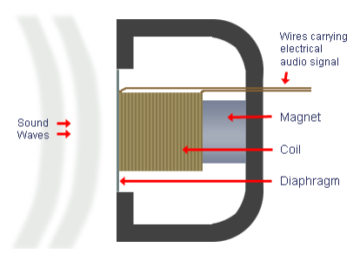
Input...
Sound is made of sound waves or air vibrations. Louder sounds produce larger vibrations.
The sound sensor has a thin piece of material called a diaphragm that vibrates when hit by sound waves (similar to how your eardrum vibrates when hearing sound).
The air pressure vibrations make the diaphragm move, and this diaphragm motion is sensed and converted into electrical signals.
The microphone (on the left) has a diaphragm that moves with sound. This motion is converted to electricity using a magnet and coil.
The sound sensor records the sound in the surroundings and converts it to a digital form using the formula (V_{range} * sensor_AO / 2¹²)
The sound signal obtained would be sent to the board (via communication lines) for further processing and for sending to the server

Slide 7
At the board..
The code uploaded on the board processes the sound signal obtained from the sensor.
It also checks the loudness of sound by calculating its dB value. (Source:https://forum.arduino.cc/index.php?topic=534279.0)
If the dB value reported is more than the threshold value, we can alert the source of sound (in case it is a person/group of people) to stop the sound.
We take 10 consequtive values of the sensor reading and get the maximum reading. Then we send the value to the server.

Slide 8
At the server…
There is a one M2M connection between the board and server.
At the server, further analytics would be done to monitor the noise at different times of the day and days of the week, and also to determine the source of the sound (extension of the project).
Sample analytics may include
A graph of the amplitude of sound with time of the day, given the day
A graph of the mean amplitude of sound for each time slot and day, for each month
A report on the number of incidents (Noise level becoming above the threshold value)
A noise map of the campus (extension of the project)
A 3D noise map of the hostels (due to the traffic, which cannot be controlled by the campus) that can be used in the future to design better noise-free and comfortable hostels.

Slide 9
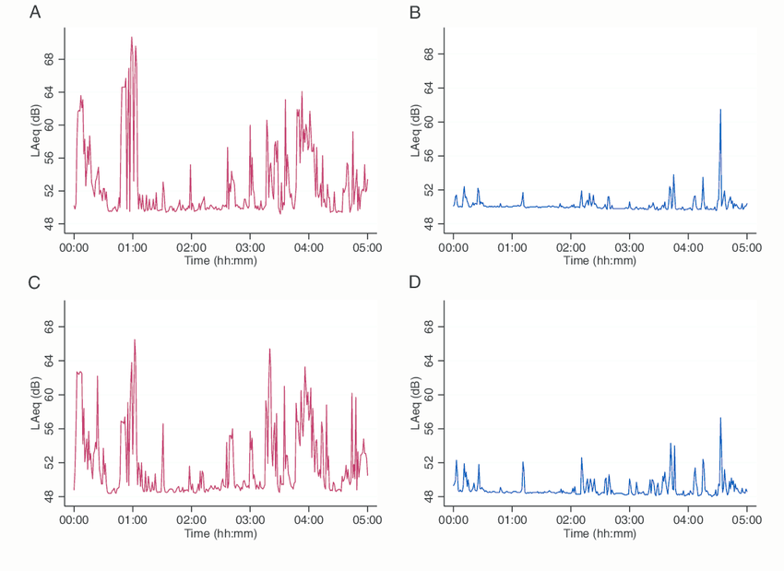
Sample graph with the values
DATE (today) / TIME | VOLTAGE x 100 (0-500) (Sensor output * 500) / (2^12) | INTENSITY (calculated as (V/500) * I0
00:00:00 | 0.0000 | 00.0
00:00:15 | 10.8884 | 24.2
00:00:30 | 6.4781 | 14.4
00:00:45 | 15.9900 | 35.6
00:01:00 | 3.3188 | 7.4
00:01:15 | 11.8484 | 26.4
00:01:30 | 5.6306 | 12.5
00:01:45 | 9.7482 | 21.7
00:02:00 | 6.4781 | 14.4
https://www.researchgate.net/figure/LAeq-values-of-measurement-1-M1-during-core-night-time-Shown-is-door-N1-D-upper_fig4_303707588
Working of the sensor given the sound (as in link): https://youtu.be/80WZ1VmGmRg

Slide 10
END RESULT
With the data harvested from the sensor, we observe the following trends:
Basic analytics on the noise disturbances (like the days/timing of these disturbances, when is it maximum, what is the mean noise level in the campus etc.)
Tentative plan to send alerts to the concerned authorities when high noise levels occur for more than 5 minutes.
Attempt to mitigate the noise by informing the concerned authorities
Make a noise map of the campus to report the more noise prone areas, and suggest ways to mitigate it
Make a 3D noise map of the hostels (by placing sensors on every floor of the hostel) and determine which floors are more noise prone.
Can be used in the future while designing hostels

Slide 11
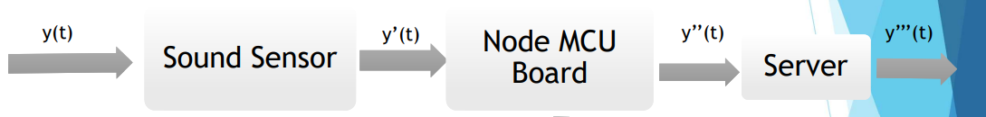
BLOCK DIAGRAM
y(t) : The sound/noise in the surroundings
y’(t) : The sound sensor reading
y’’(t) : The selected sound dB readings with the additive white noise removed. Any error in reading if present is also removed
y’’’(t) : The statistical data of the sound produced

Slide 12
Each block explained
BLOCK | INPUT | OUTPUT | PROCESSING
Sound Sensor | Sound energy from the surroundings | Sound loudness (in analog output form) | Collects the sound energy from the surroundings using the mic and convert it to analog voltage signals using the ADC.
Node MCU Board | Sound recording (in digital form) | Loudness of the sound (in dB) | Obtain the decibel value of the sound recorded for real time feedback Sends the recording with the noise removed to the server for processing
Server | Loudness of the sound (in dB) | Graph of the dB value and number of events with time and day and location Different statistical measurements (like mean loudness, max and min loudness per day, noisiest part of the day etc.) Places which are more prone to noise pollution than others (extension of project) | By placing the measurement units at different places within the campus and analysing their outputs graphically at the server end (using code written in some language like C), we can obtain the most noise prone areas within the campus. The number of the events (loudness being above the threshold) vs sensor location is also calculated. On an extension of the project, if the sound is above the threshold for a really long time (like 30 min), the sound is processed and the main reason of the sound can be determined. (traffic/students/stadium)

Slide 13
THANK YOU!

